Slide 1

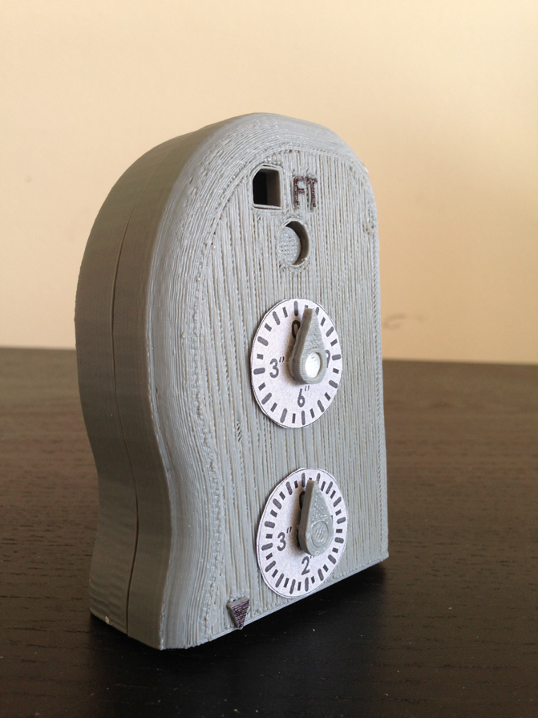
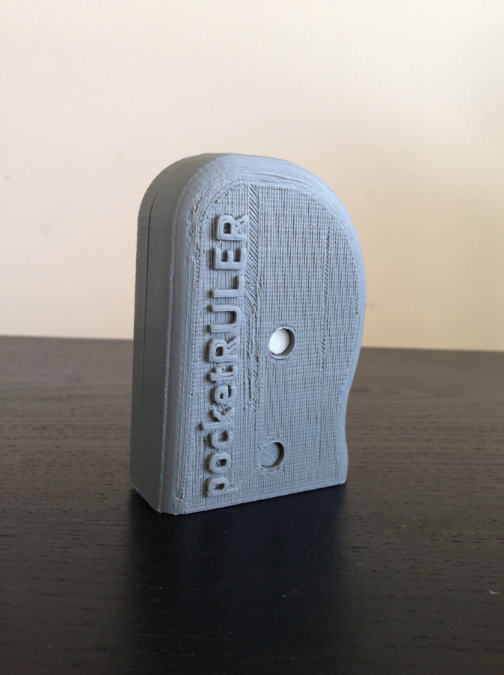
pocketRULER
Alec Fredriksson Shannon Lai Simond Liu Wilson Lam

Slide 2

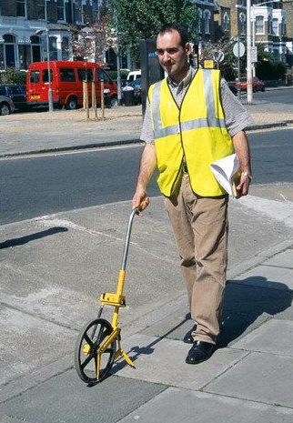
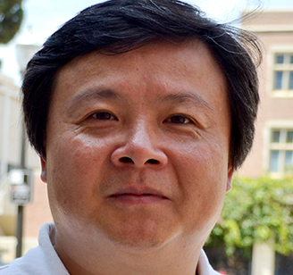
Background
Problem:
Rulers are not compact measuring devices
Tape measures are limited to measuring straight lines
Wanted a compact device that measures curves and complex geometries for long distances (at least a foot)
Concept was inspired by a tool called a surveyor’s wheel
Used for measuring distances on the scale of hundreds of feet

Slide 3
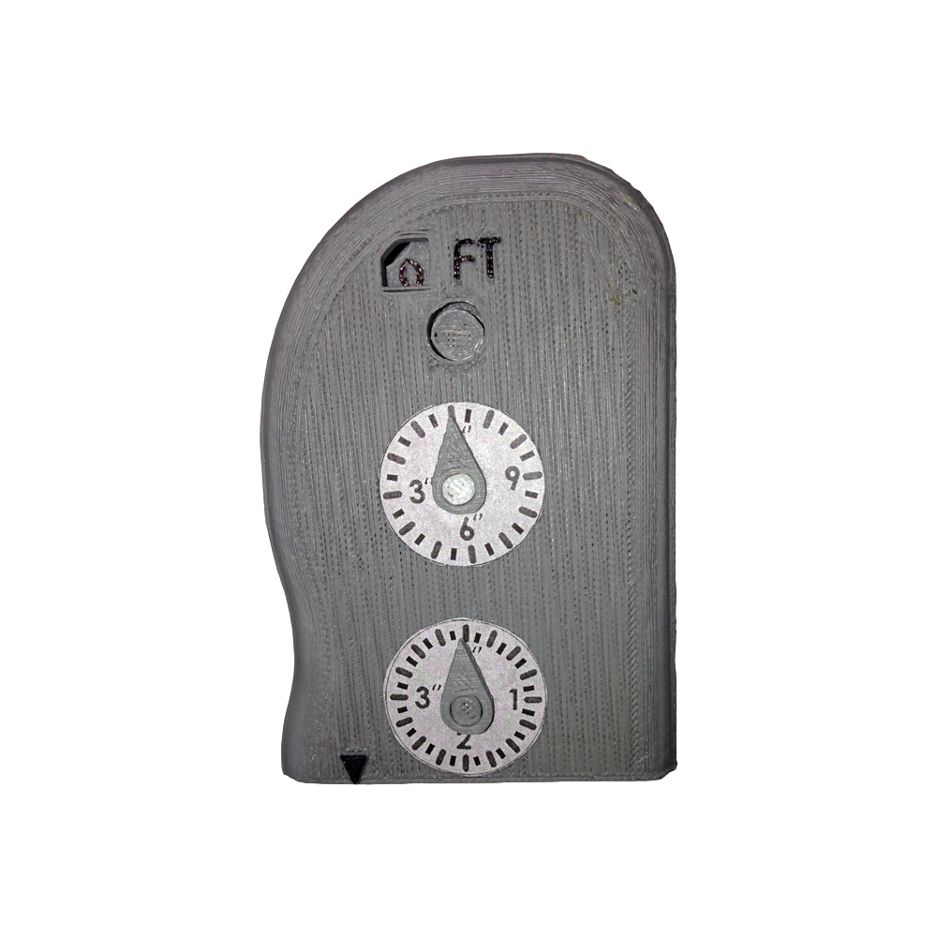
The Product: pocketRULER
Feet Indicator
(up to 5 ft)
Inches indicator
(up to 12 in)
PULL TO MEASURE
Precision indicator (resolution of up to 1/8 in)
Alignment arrow
Measuring wheel

Slide 4
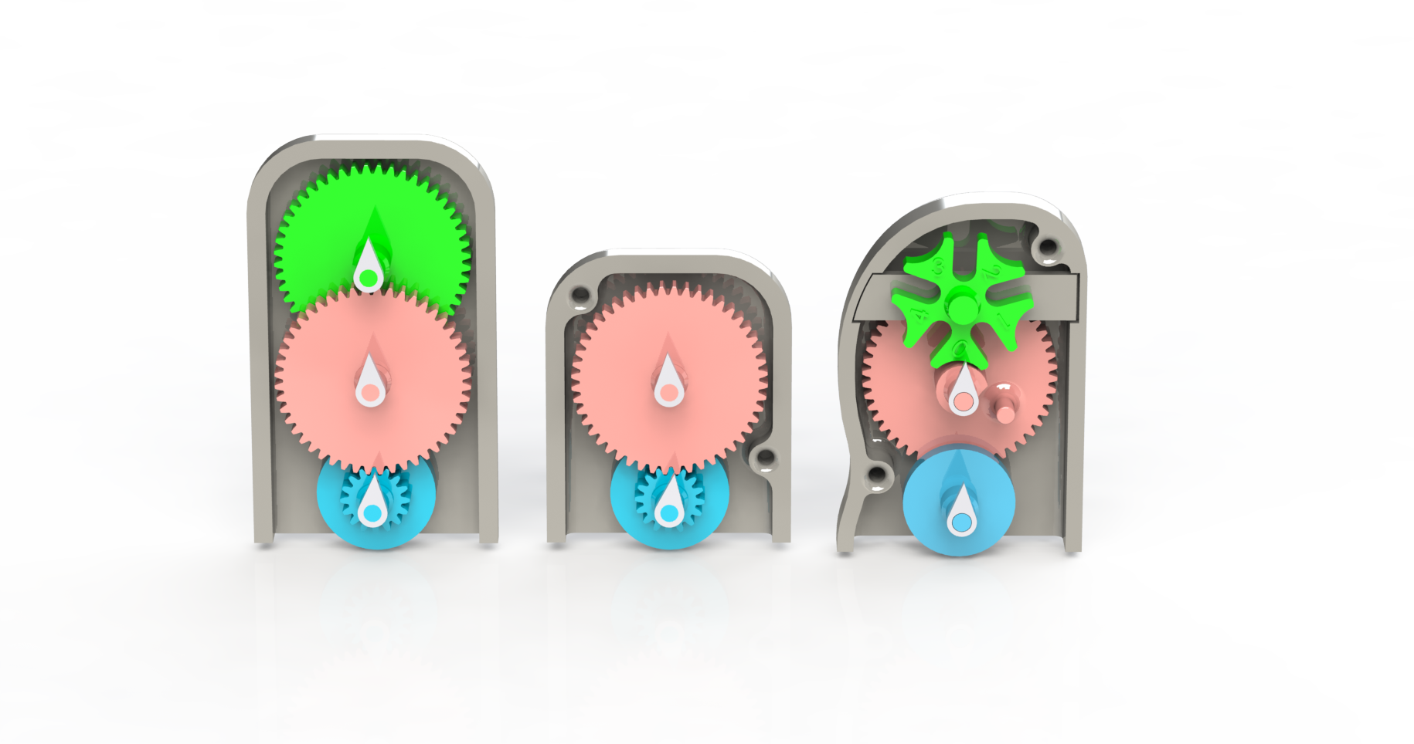
Design Iterations: Overview
Max distance: 4 feet 1 foot 5 feet
Height: 4.5 inches 3.2 inches 3.9 inches
Cycle 1 Cycle 2 Cycle 3

Slide 5
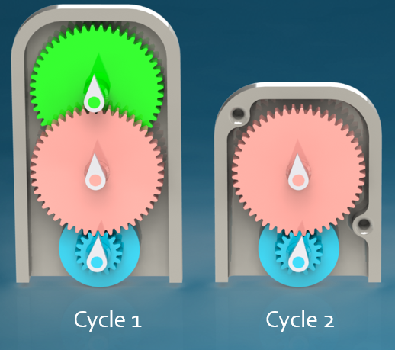
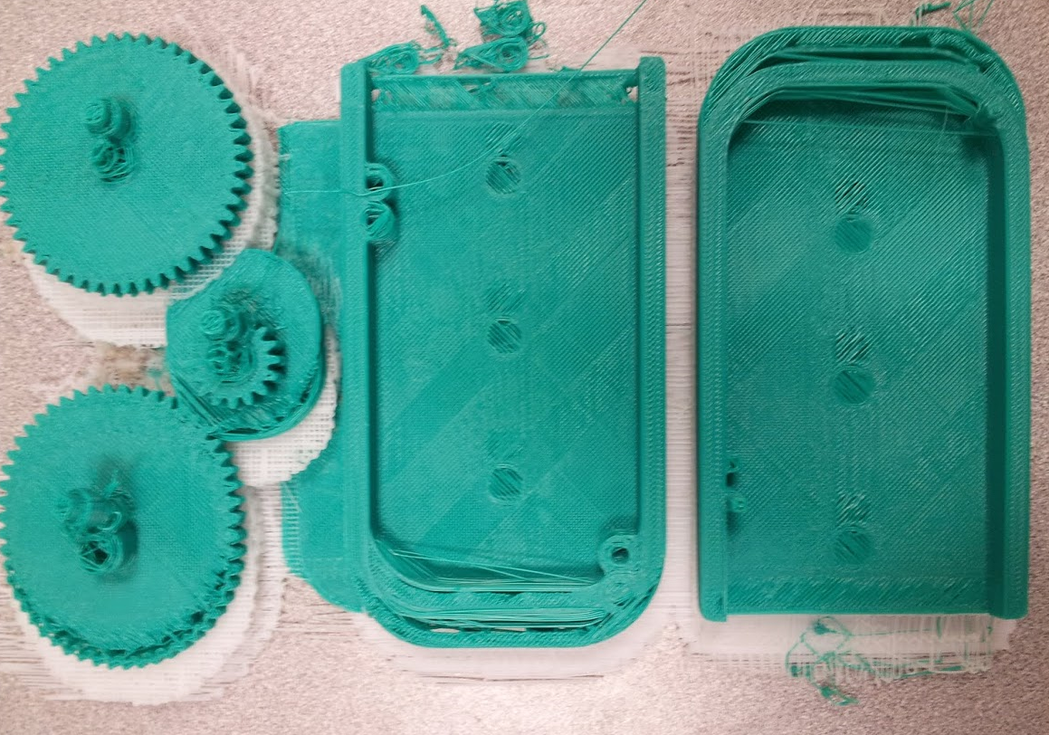
Design Changes: Cycle 1 t0 Cycle 2
Shafts are not center
Lessons Learned from Cycle 1
MakerBot has trouble handling prints that take up most of the working surface
Need to increase tolerances
Changes from Cycle 1 to Cycle 2
Removed large gear (measured up to 4 feet)
Can only measure up to 1 foot
Shifted printing
Print 1

Slide 6
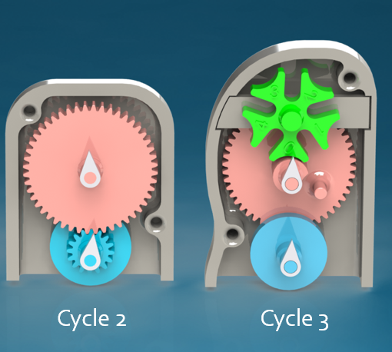
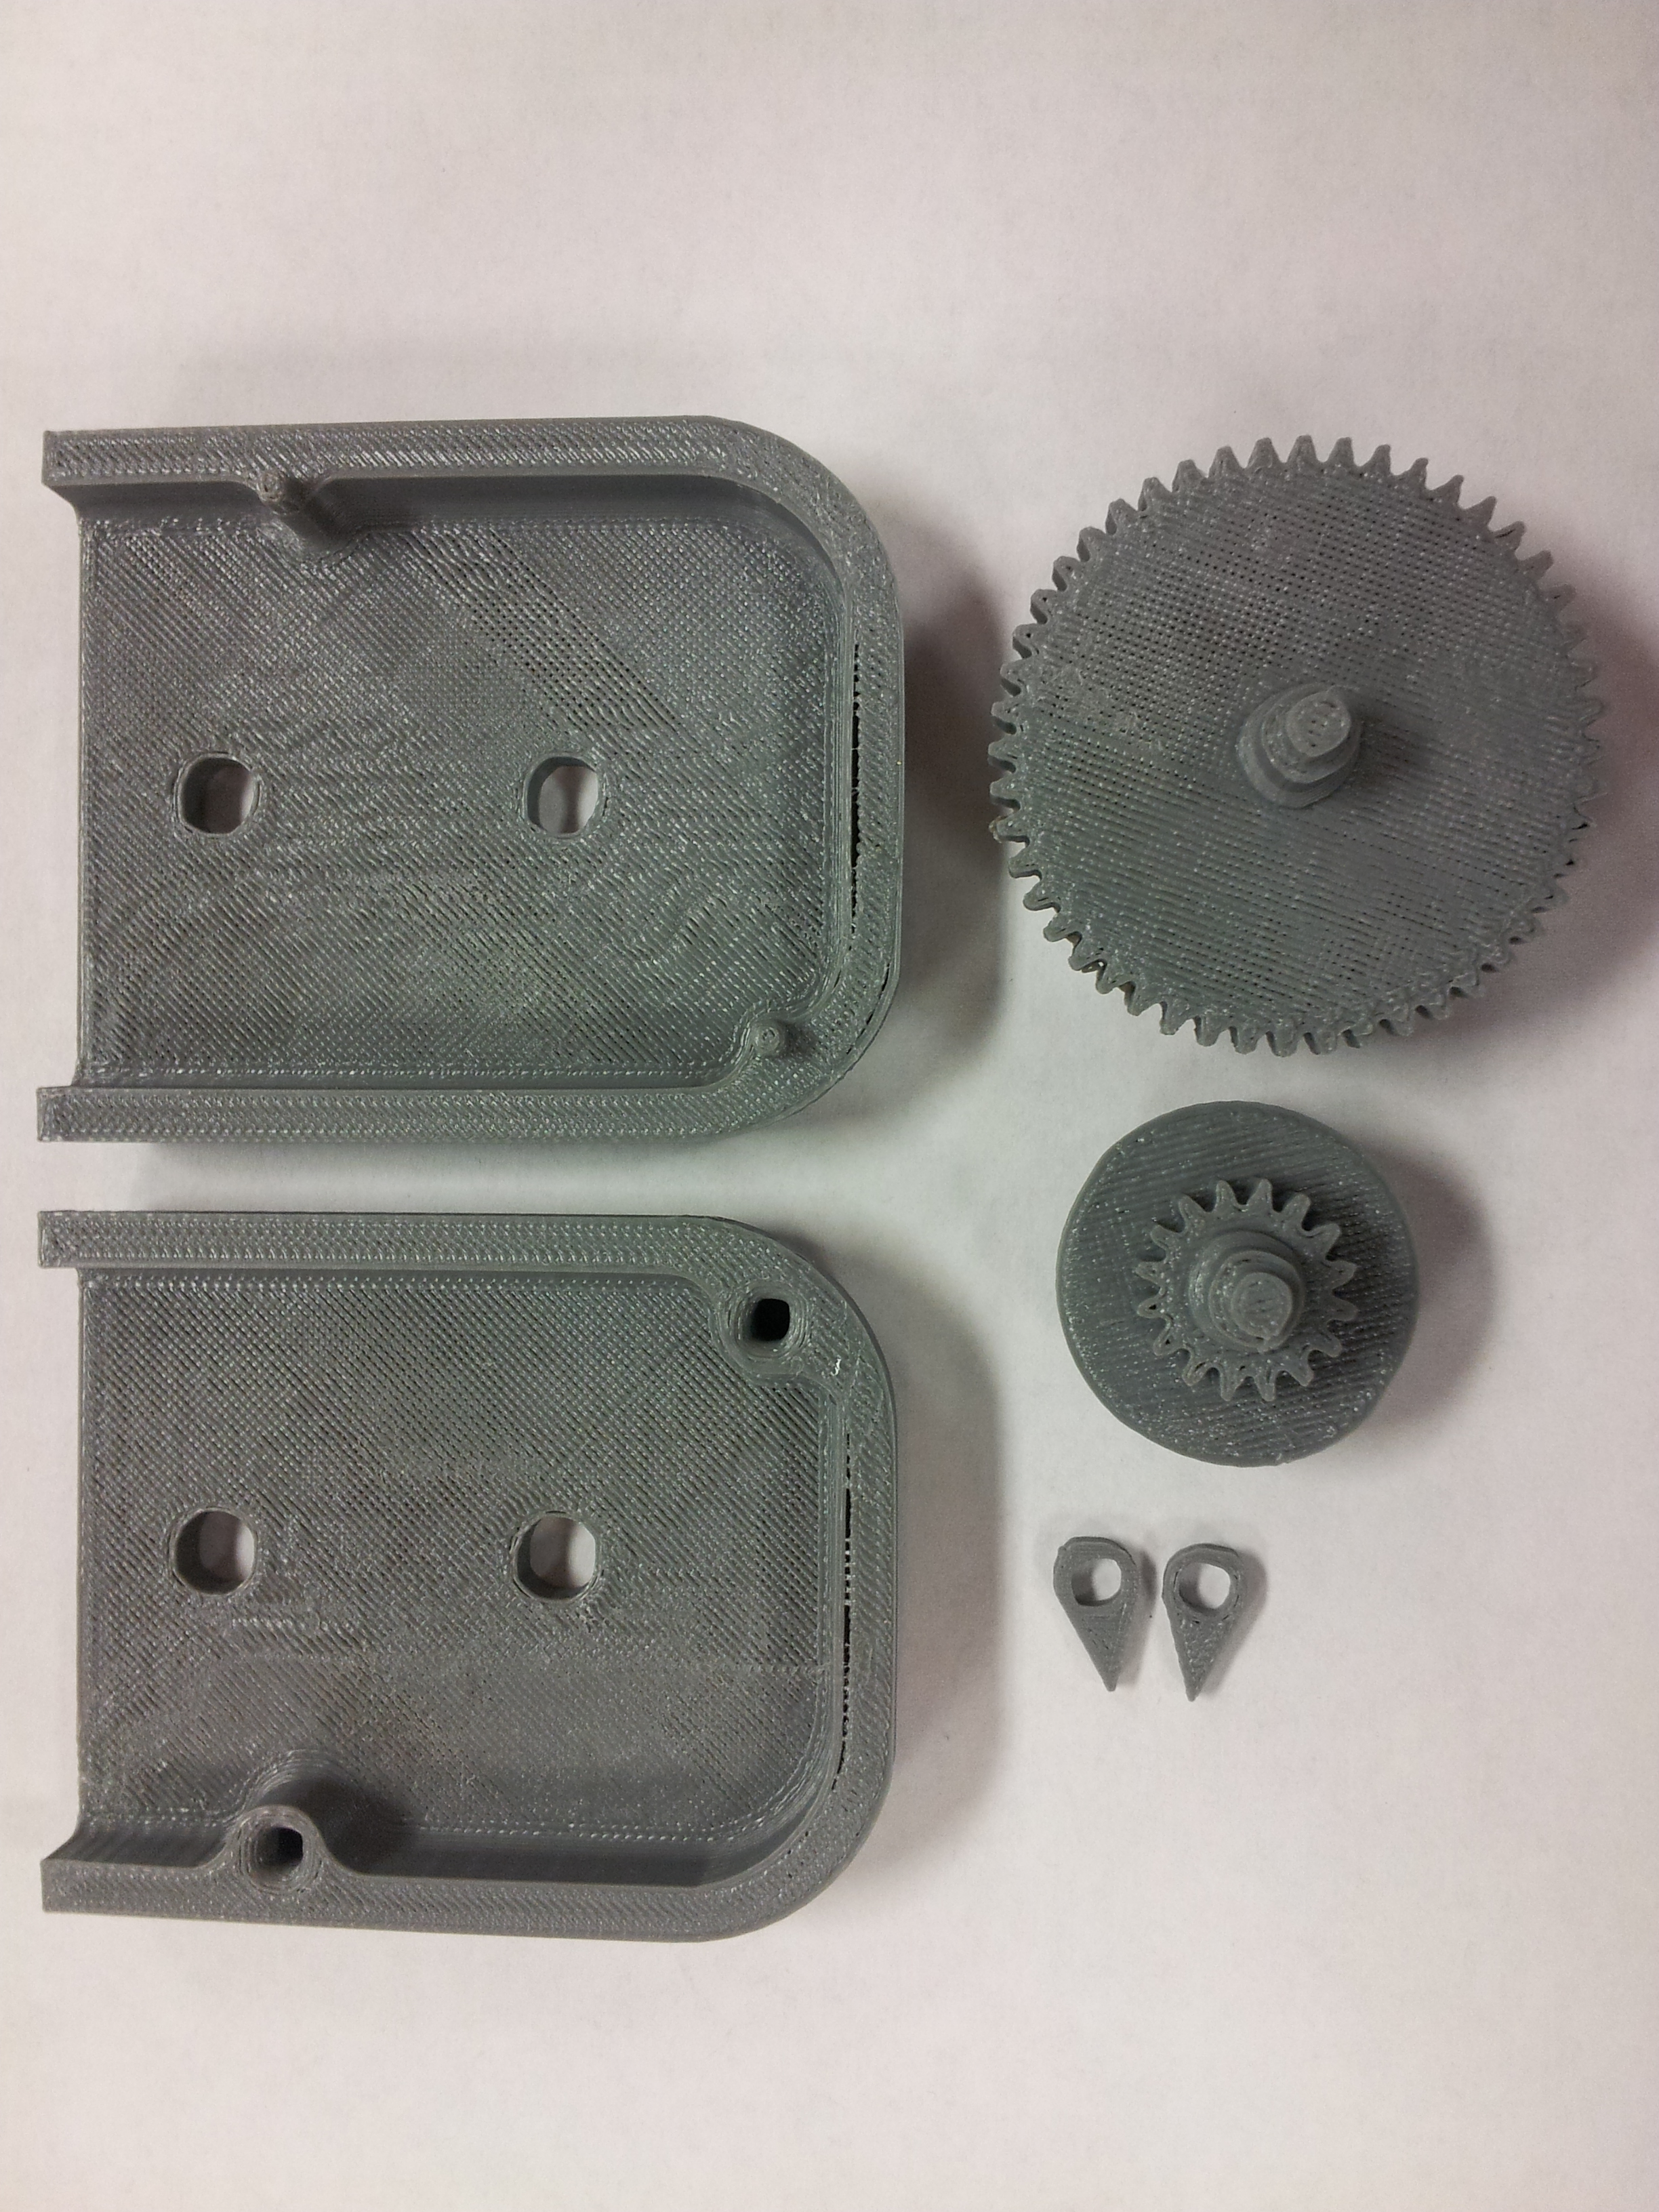
Design Changes: Cycle 2 t0 Cycle 3
Lessons Learned from Cycle 2
MakerBot is capable of printing functional gears
Changes from Cycle 2 to Cycle 3
Added Geneva Gear to increase functionality up to 5 feet
Ergonomic contours
Print 2

Slide 7
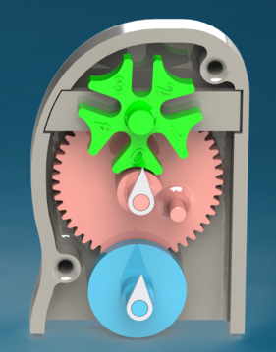
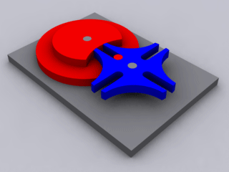
Final Design
Purpose of Geneva gear
Moves in intervals, unlike a traditional gear, thus smaller size
Easier for MakerBot to print
Did not need feet indicator to displayed in between feet
Geneva Gear
Increased measurement capability from 4 feet to 5 feet from Cycle 1 Design, while decreasing size 15%
Cycle 1 Cycle 2 Cycle 3
http://ilovesmesomeska.deviantart.com/art/Geneva-Drive-63040772

Slide 8
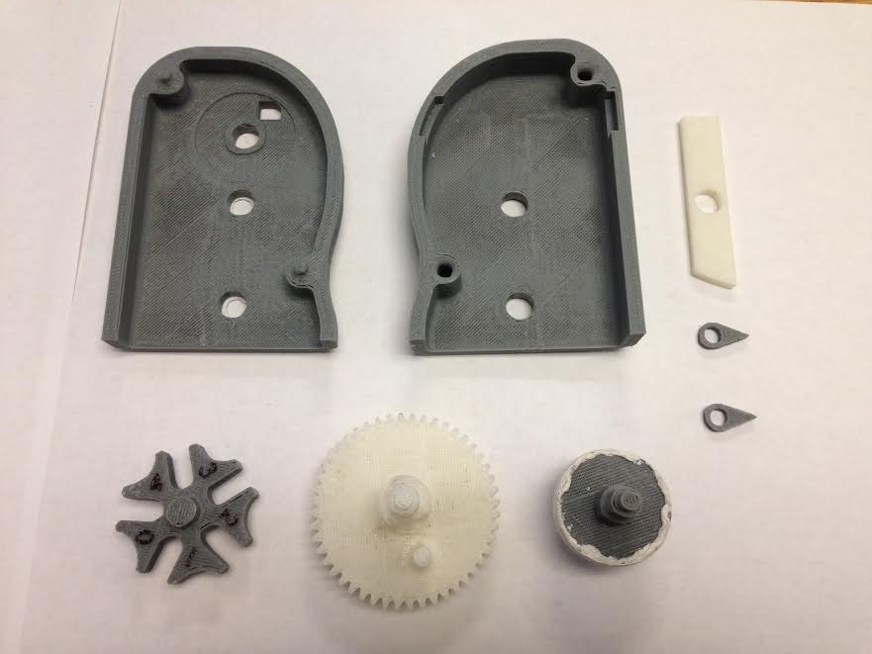
Final Print Results
Printed well
Correct tolerances

Slide 9
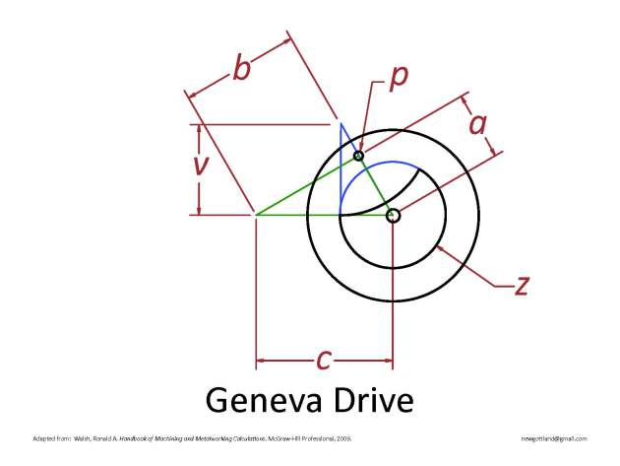
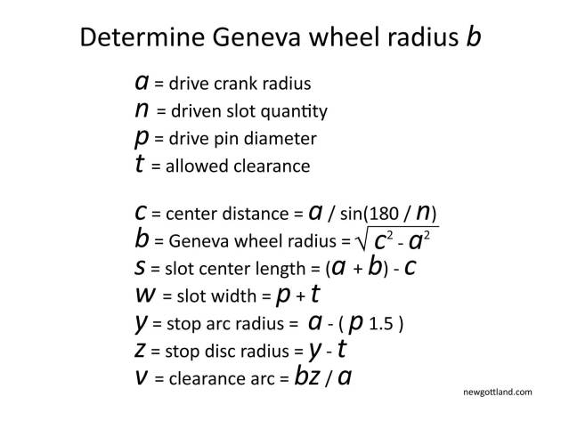
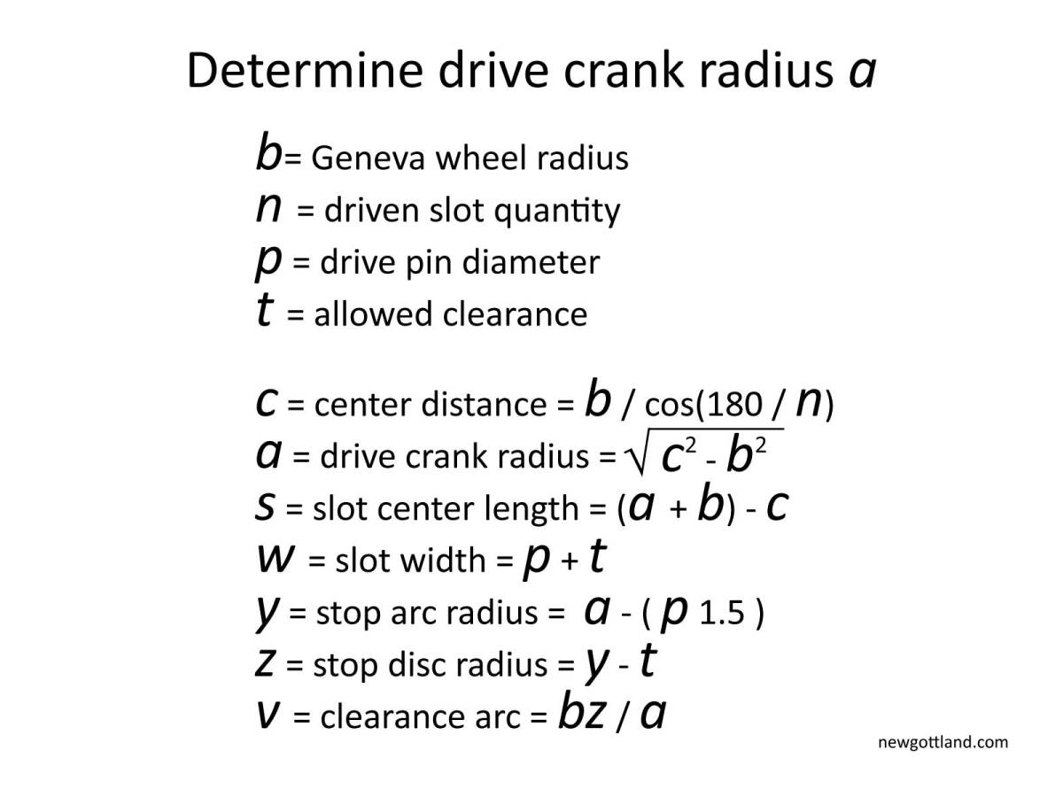
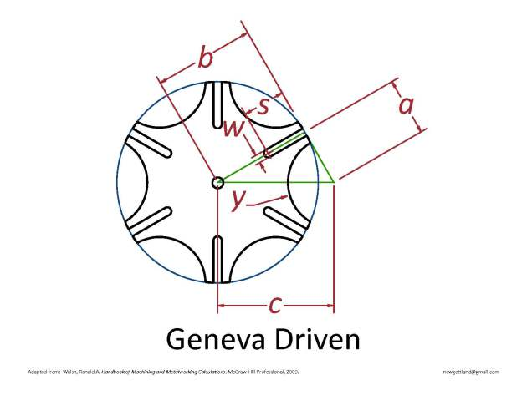
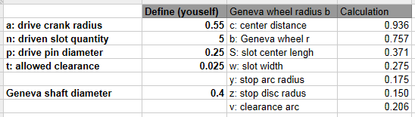
Geneva Gear Analysis
Our Numbers
*inches
http://newgottland.com/2012/01/08/make-geneva-wheels-of-any-size/

Slide 10
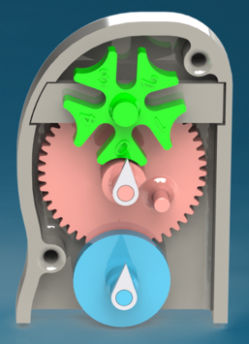
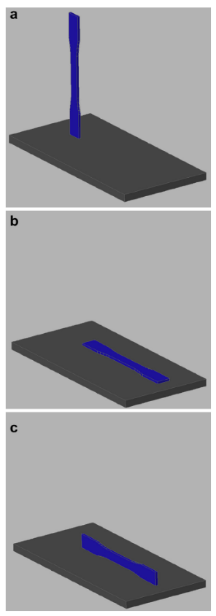
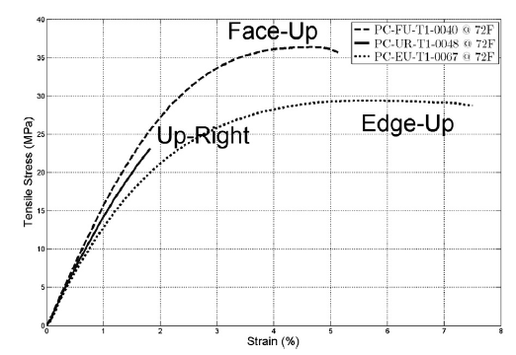
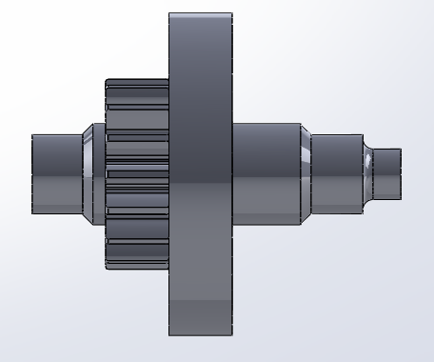
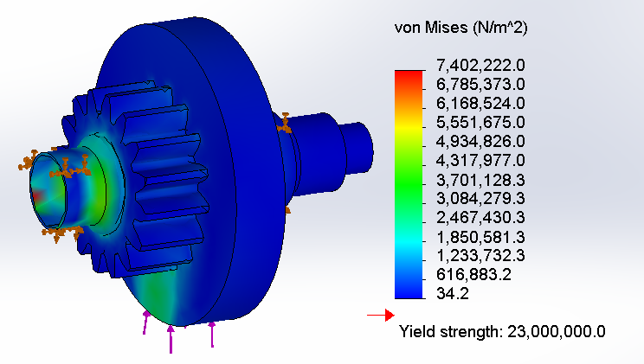
FEA on Wheel
There are 3 main print orientation:
Up-Right (shown)
Edge-Up
Face-Up
Average Human Arm-Hand Weight:
3.35 kg (7.39lb) → 33 N
FEA Tested at:
10.2 kg (22 lb) → 100 N
Maximum Load
60 lb
Reaction Force from Surface

Slide 11
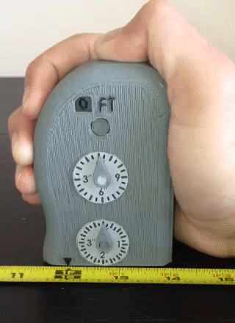
Functionality
Can measure up to 5 feet
Accurate to within 1% (only 1/8” deviation when measuring 1 foot)
Meets our objective of being able to accurately measure lines and curves

Slide 12
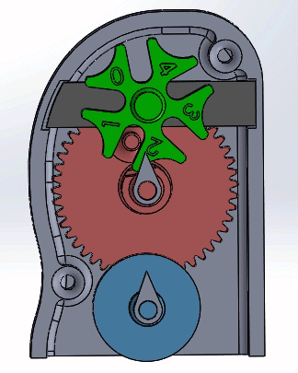
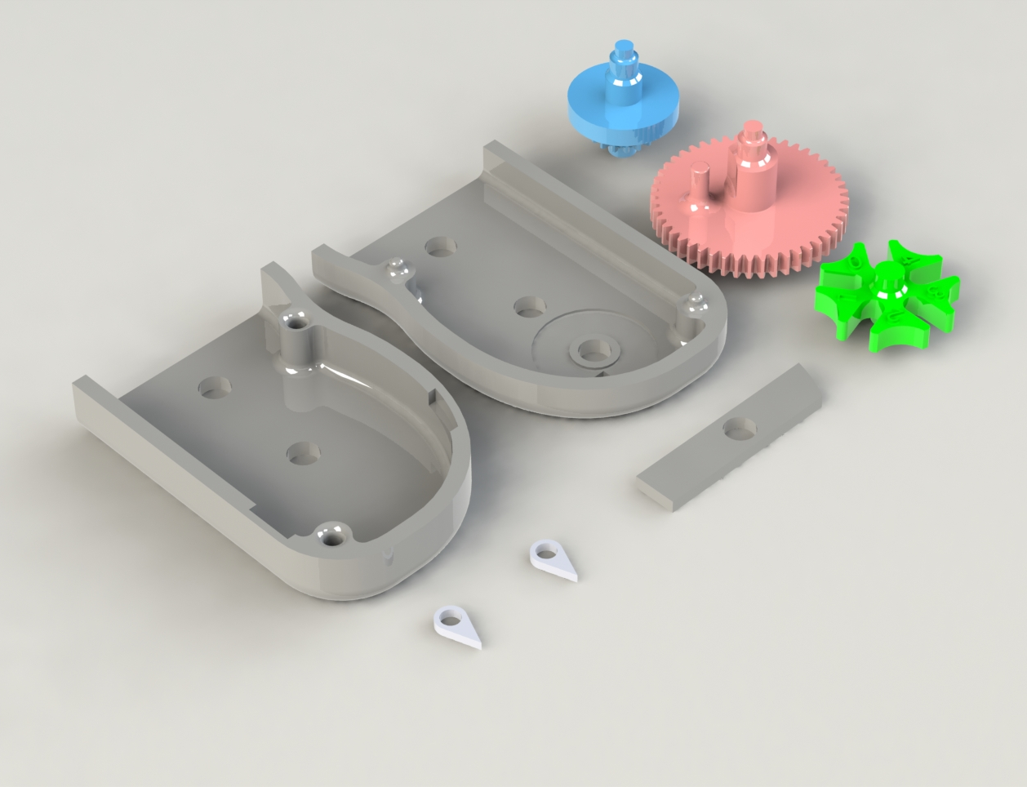
Complexity and Difficulty
2 different types of mechanisms
Spur gear
Geneva gear
8 separate parts
2 housings
2 indicators
1 intermediate support wall
2 spur gears
1 Geneva gear
Tight tolerances needed for gear to mesh properly

Slide 13
Aesthetics
Housing has ergonomic contours to better fit the user’s hand
Large radius fillets are used to make housing edges more comfortable
Product name is embossed on housing

Slide 14
Future Improvements
Reduce size of product
The gears limited the minimum size we could make our product. They needed to be printed large enough such that their teeth were well defined
By gaining access to a machine with tighter tolerances, it should be possible to reduce the size of our product by 50%
Possibility of using two Geneva gears
Increase accuracy from 1% to 0.05%
Increase maximum length device can measure
Reset mechanism to go to back to 0 feet

Slide 15
Questions?
Special thanks to
Professor Li
Injoo Hwang

